Slide 1

Texas REALTORS® Executive Board
December 2022 Financials
February 14, 2023

Slide 2
Balance Sheet

Slide 3


Total Assets – December 2022

Slide 4
Total Liabilities – December 2022

Slide 5
Total Current Assets Over Total Current Liabilities – December 2022

Slide 6
Issues Mobilization/Political Advocacy Fund – December 2022

Slide 7
Issues Mobilization/Issues Advocacy Fund – Expenditures Since Inception
(Top 10 Expenditure Categories)
Expenditures by Year
2016 | $38,411
2017 | $1,986,674
2018 | $2,173,197
2019 | $2,191,399
2020 | $2,119,699
2021 | $1,489,615
2022 | $1,750,236
Total Expenditures Since Inception - $11,749,230

Slide 8
Legal Defense Fund – December 2022

Slide 9
Building Fund – December 2022

Slide 10
Texas REALTORS® Disaster Relief Fund for Texans – December 2022

Slide 11
Texas REALTORS® Disaster Relief Fund (REALTORS® -only) – December 2022

Slide 12
Income Statement

Slide 13

Dues Revenue – December 2022
Up 7% from
December 2021

Slide 14
Member Counts – December 31, 2022
3% YoY increase in REALTOR® count

Slide 15
Revenue & Expenses – December 2022
Unrealized Gains
2021 - $5,537,999
2022 – ($14,739,970)

Slide 16
Net Income without Non-Cash Items

Slide 17
Unrealized Gains vs. Interest/Dividends/Realized Gains

Slide 18
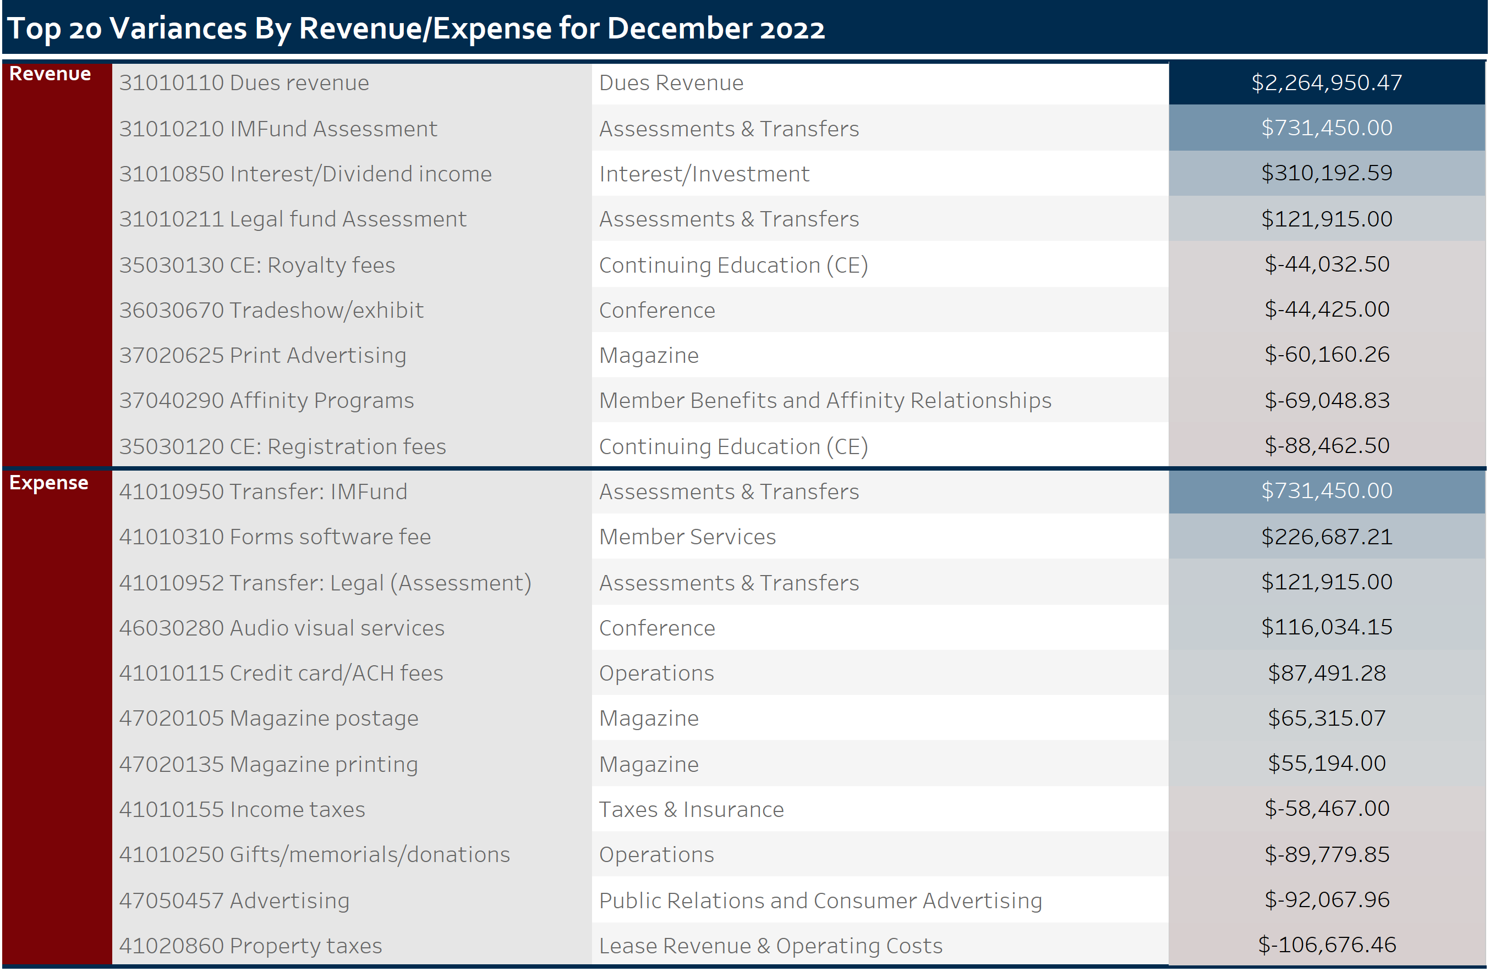

Slide 19
Texas REALTORS® Issues PAC Financials
Comparative Income Statement
Balance Sheet

Slide 20
December 2022 Financials

