Slide 1
Texas REALTORS® Regional Vice Presidents Workshop
Thursday, August 21, 2025

Slide 2

Role of a Regional Vice President
Serve on the Executive Board - Decisions based on the best interest of Texas REALTORS®
Promote the positions of Texas REALTORS® - You are officers of Texas REALTORS® and have a fiduciary duty to the organization. You are brand ambassadors and are vital to two-way communications between state and local.
Foster teamwork - Work with TREPAC Trustees and Political Involvement Committee members to increase proactive involvement
Notes:
Jennifer

Slide 3

Role of a Regional Vice President
Talk to your AEs and Presidents regularly – They are key partners. Keep them informed. Value them. Seek input.
Be available and be relevant – then be enthusiastic and grateful
Build trust and develop new leaders – cheer and champion everyone you can
Mentor your replacement – equip them to step right in and do even better than you did!

Slide 4

Fiduciary Duties
Who do you represent?
Large firm, Small firm, Franchise, Commercial, Farm & Ranch? Membership? Region? Local Association?

Slide 5
Fiduciary duty requires you to make careful, good-faith decisions in the best interest of the association.
Care
Obedience
Discharging one’s responsibilities in a reasonably
attentive and diligent fashion
Obligation to abide by the bylaws, policies, and
other governing documents of the association,
and to support the association’s board of directors.
Loyalty
Confidentiality
Always acting in the best interests of the
association, rather than in the interests of oneself
or another person or entity.
Restricts how you can share information and with
whom you may share it.

Slide 6
Fiduciary Duty – What you have agreed to
You have a special legal responsibility in connection with the administration, investment and care of Texas REALTORS® and its assets. This requires you to make careful, good-faithed decisions in the best interest of Texas REALTORS®. Your decisions must be made independently and free of any undue influence from any person or organization, including any local association, MLS or brokerage.
Many of you are multi-board directors/officers, meaning that you also serve as directors of other organizations, such as local associations and MLSs. In that instance, you owe fiduciary duties to multiple organizations. If the duties you owe to another organization prevent you from giving undivided allegiance to Texas REALTORS®, then you are independently responsible for addressing that conflict as you deem appropriate and at the very least, in a manner consistent with Texas REALTORS®’ Conflict of Interest Policy.

Slide 7


Confidentiality
Generally, confidentiality includes:
Ethics/Professional Standards
Litigation/Legal Advice
Personnel/Employment
Information received from others
Contract negotiations

Slide 8

Loyalty
Does the duty of loyalty conflict with freedom of speech?

Slide 9








Key Responsibilities & Policies
Confidentiality
Antitrust
Whistleblower
Harrassment
Social Media
Travel

Slide 10

Key Responsibilities
Texas REALTORS® 360 Mega-Regional Meetings
Facilitate a consensus regarding a host and date for the meeting. Must be approved by all associations in the region. Report to Meeting Planning (360meetings@texasrealtors.com)
Promote meeting attendance to local associations and encourage attendance.
See Guidelines & Checklist on RVP site

Slide 11


Key Responsibilities
Election of Regional Credentials Committee Member and Alternate
RVPs facilitate the election of Member and Alternate for your region. RVP discretion.
“Elected directors in each Region elect one REALTOR® Member who holds Primary REALTOR® Membership in a Member Board in that respective Region to serve as an elected Credentials Committee member.”
Eligibility & Resources
Texas REALTORS® will assist.

Slide 12
Key Responsibilities
Credentials Committee Eligibility Criteria
Must be a REALTOR® member in good standing with their Member Board(s), Texas REALTORS®, and the NATIONAL ASSOCIATION OF REALTORS® (NAR);
Cannot serve consecutive full two-year terms as a Committee Member;
Cannot have received formal discipline from the Texas Real Estate Commission for a violation that falls under Section 535.191(d) or (e) of the Texas Real Estate Commission rules within seven (7) years preceding the date of the election;
Cannot have been found in violation of NAR’s Code of Ethics within three (3) years preceding the date of the election;
Must have attended four (4) out of the last six (6) annual Texas REALTORS® meetings as set forth in Article VIII of the Texas REALTORS® Bylaws;
Must have participated in Texas REALTORS® activities (e.g., served as a Texas REALTORS® Director, Committee/Task Forces participation, etc.) in the last three (3) years;
Must have done at least one of the following: a. served at least one (1) year on their local Board of Directors; served at least one (1) year on the board of a qualified Institute, Society or Council affiliated with the National Association of REALTORS®; or b. served at least one (1) term as Regional Vice President of Texas REALTORS®.

Slide 13

Attendance & Travel Policy
See Page 8 for policy specific to Regional Vice Presidents
Executive Board Meetings (mandatory)
Winter Meeting (February)
June Zoom Meeting
Budget Review (August)
Conference (August/September)
December Zoom Meeting
See the three-year calendar under Events tab at TexasRealEstate.com

Slide 14
Attendance & Travel Policy
Other Meetings
Specially-called meetings
Texas REALTORS® Leadership Summit (formerly BOLC) (Does not include REALTOR® Party Training)
Regional meetings

Slide 15

Intraregional Travel
Registration fees are reimbursable for the RVP and a guest to attend an association or regional meeting.
Tickets, fees, or incidental expenses related to social functions (e.g., golf outings, tennis tournaments, etc.) are not reimbursable.

Slide 16

Winter Meeting & Conference
3 nights covered on Texas REALTORS® master billing account
Complimentary Registration and certain event tickets
Self-parking for one vehicle per room per night – applies to all meetings

Slide 17
Winter Meeting & Conference
RVP will be personally responsible for reimbursing Texas REALTORS® for any fees incurred for non-adherence to hotel cancellation policies.
RVP will be personally responsible for reimbursing Texas REALTORS® for any room, parking and registration fees expended on behalf of the RVP if the RVP attends any portion of the meeting but does not attend the Executive Board meeting.

Slide 18
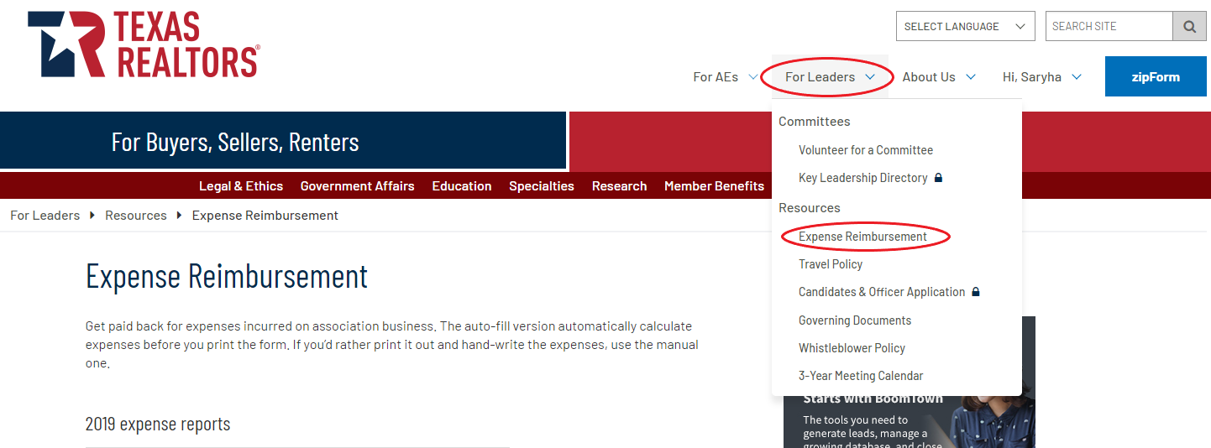
Travel Policy & Expense Reports
Travel Policy
See Page 8 for policy specific to Regional Vice Presidents
Expense forms at TexasRealEstate.com and TexasRealtorsRVPs.com
Reports must be timely – within 30 days – NO reimbursement made after 90 days

Slide 19

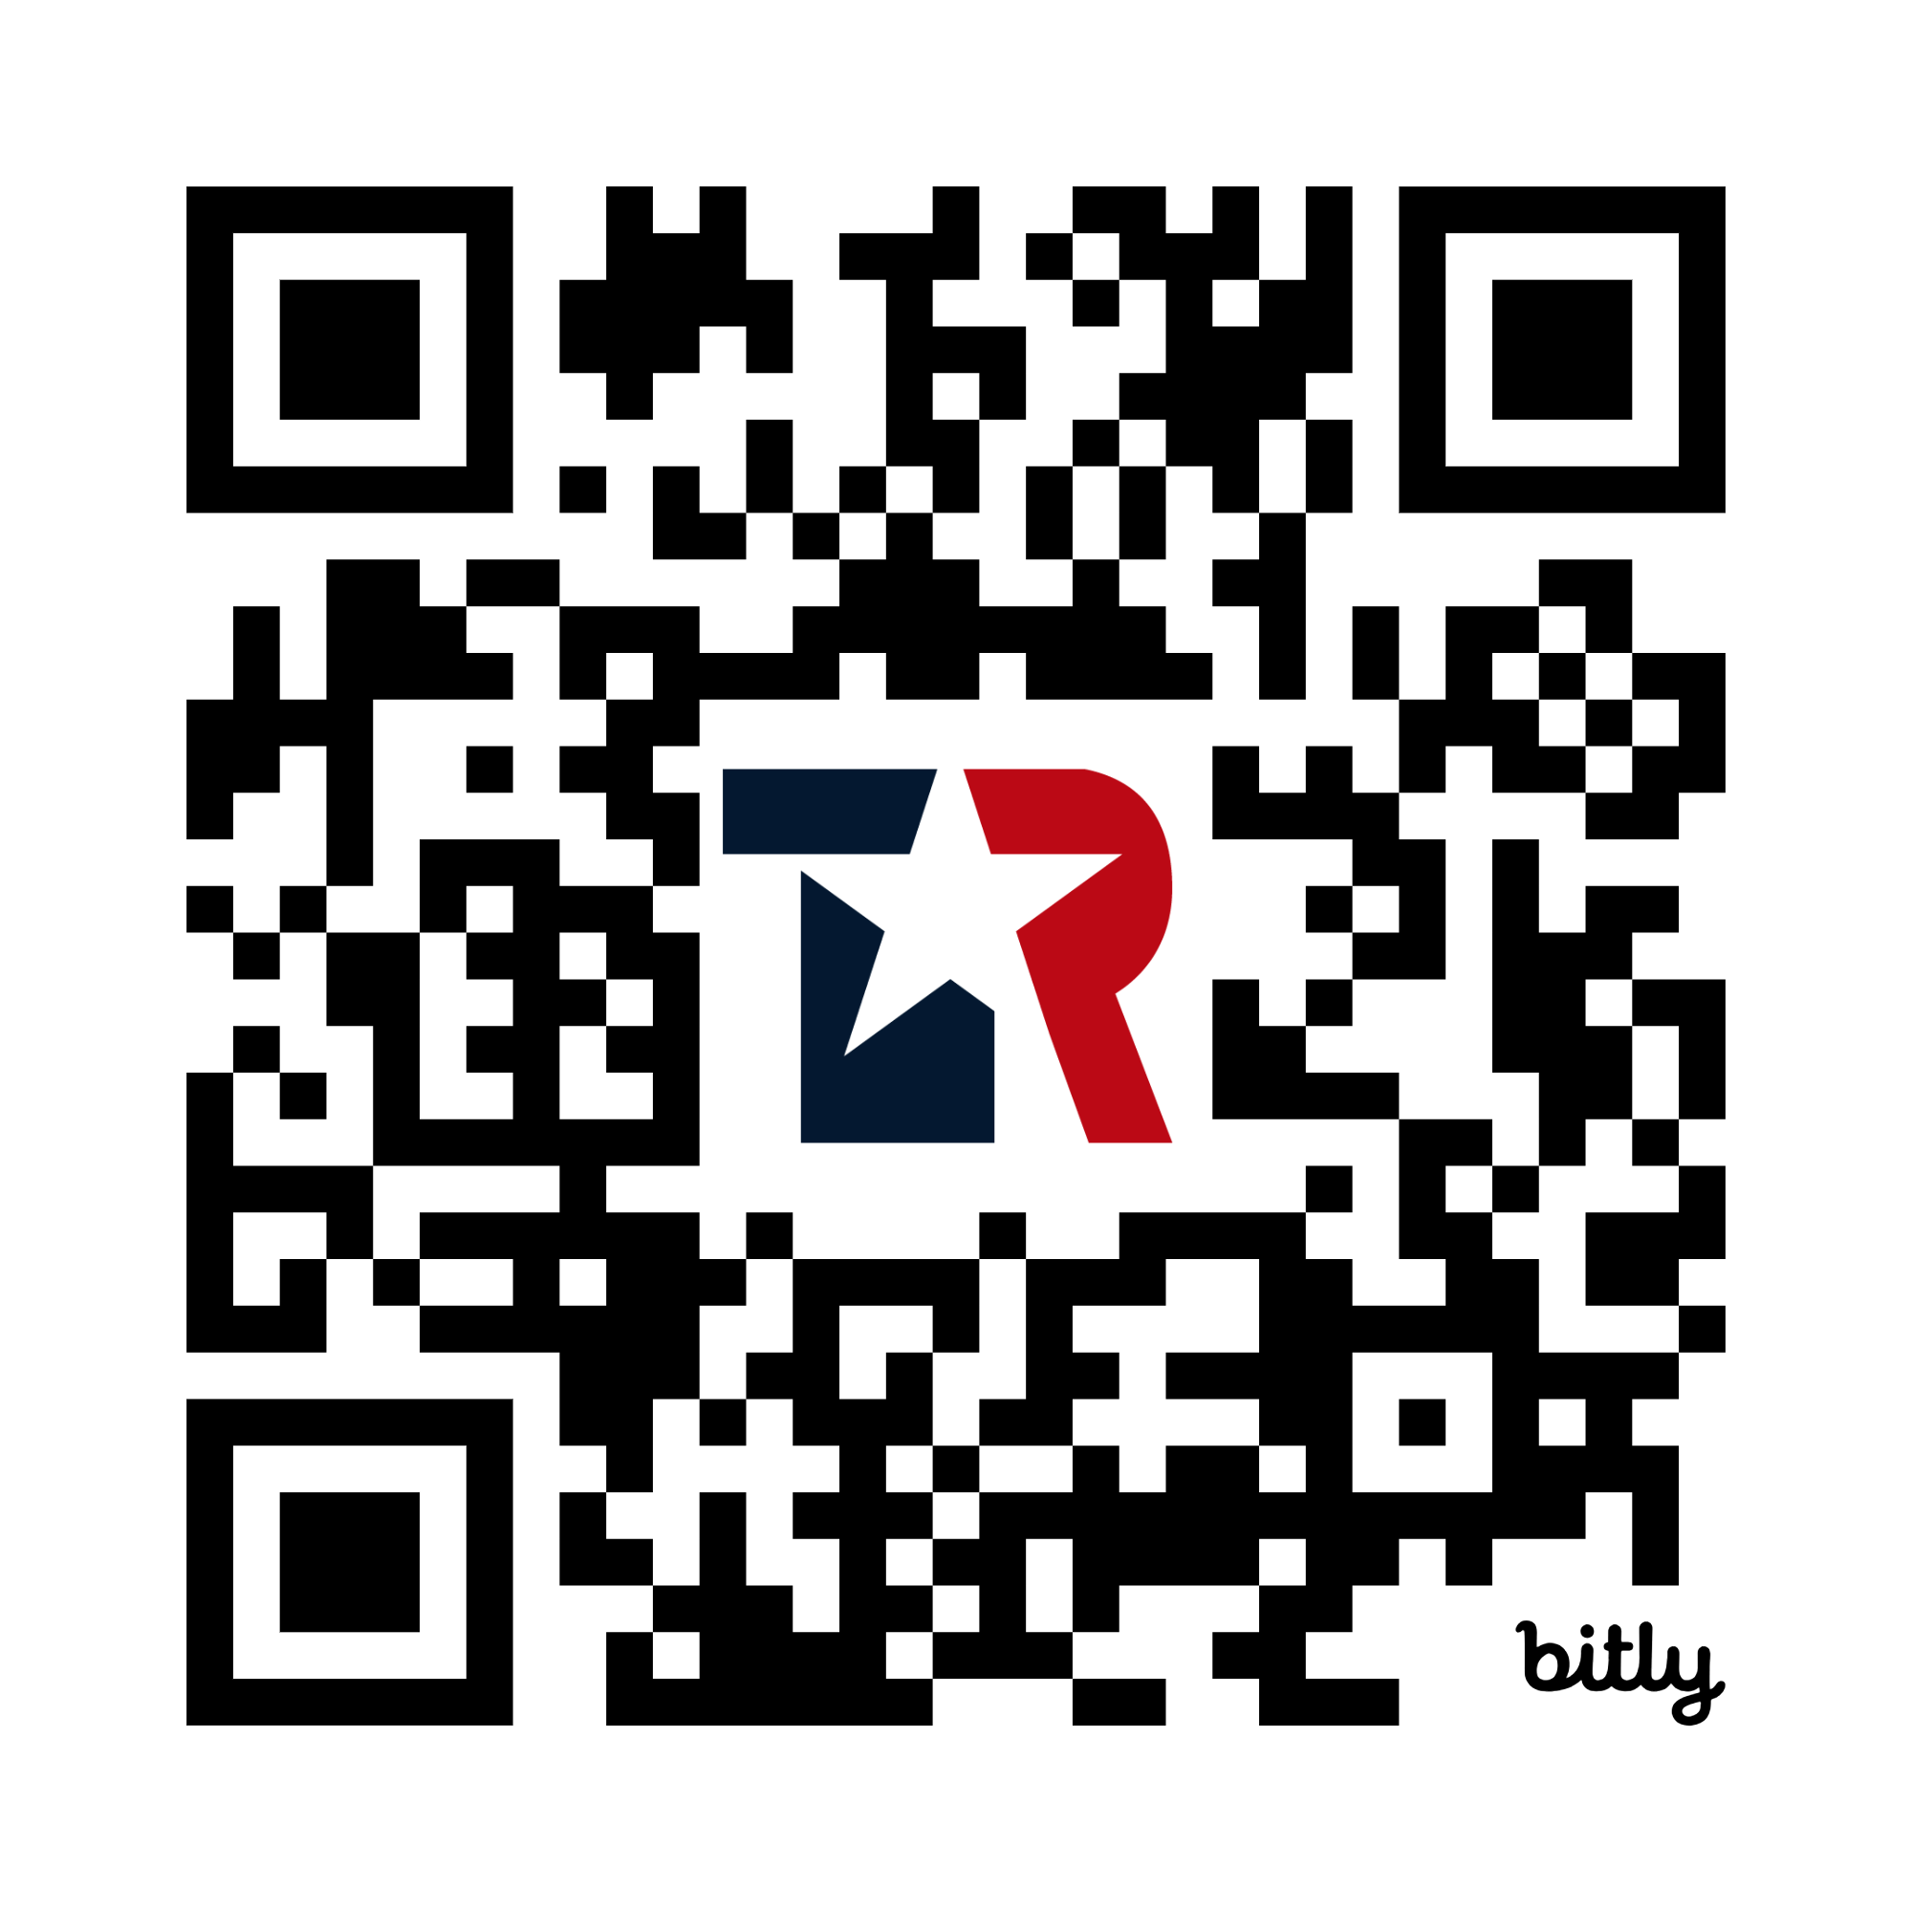
Communication & Reporting
www.texasrealtorsrvps.com
2 Regional Reports per year
due in advance of Winter Meeting & Conference
Regional Caucus Reports

Slide 20
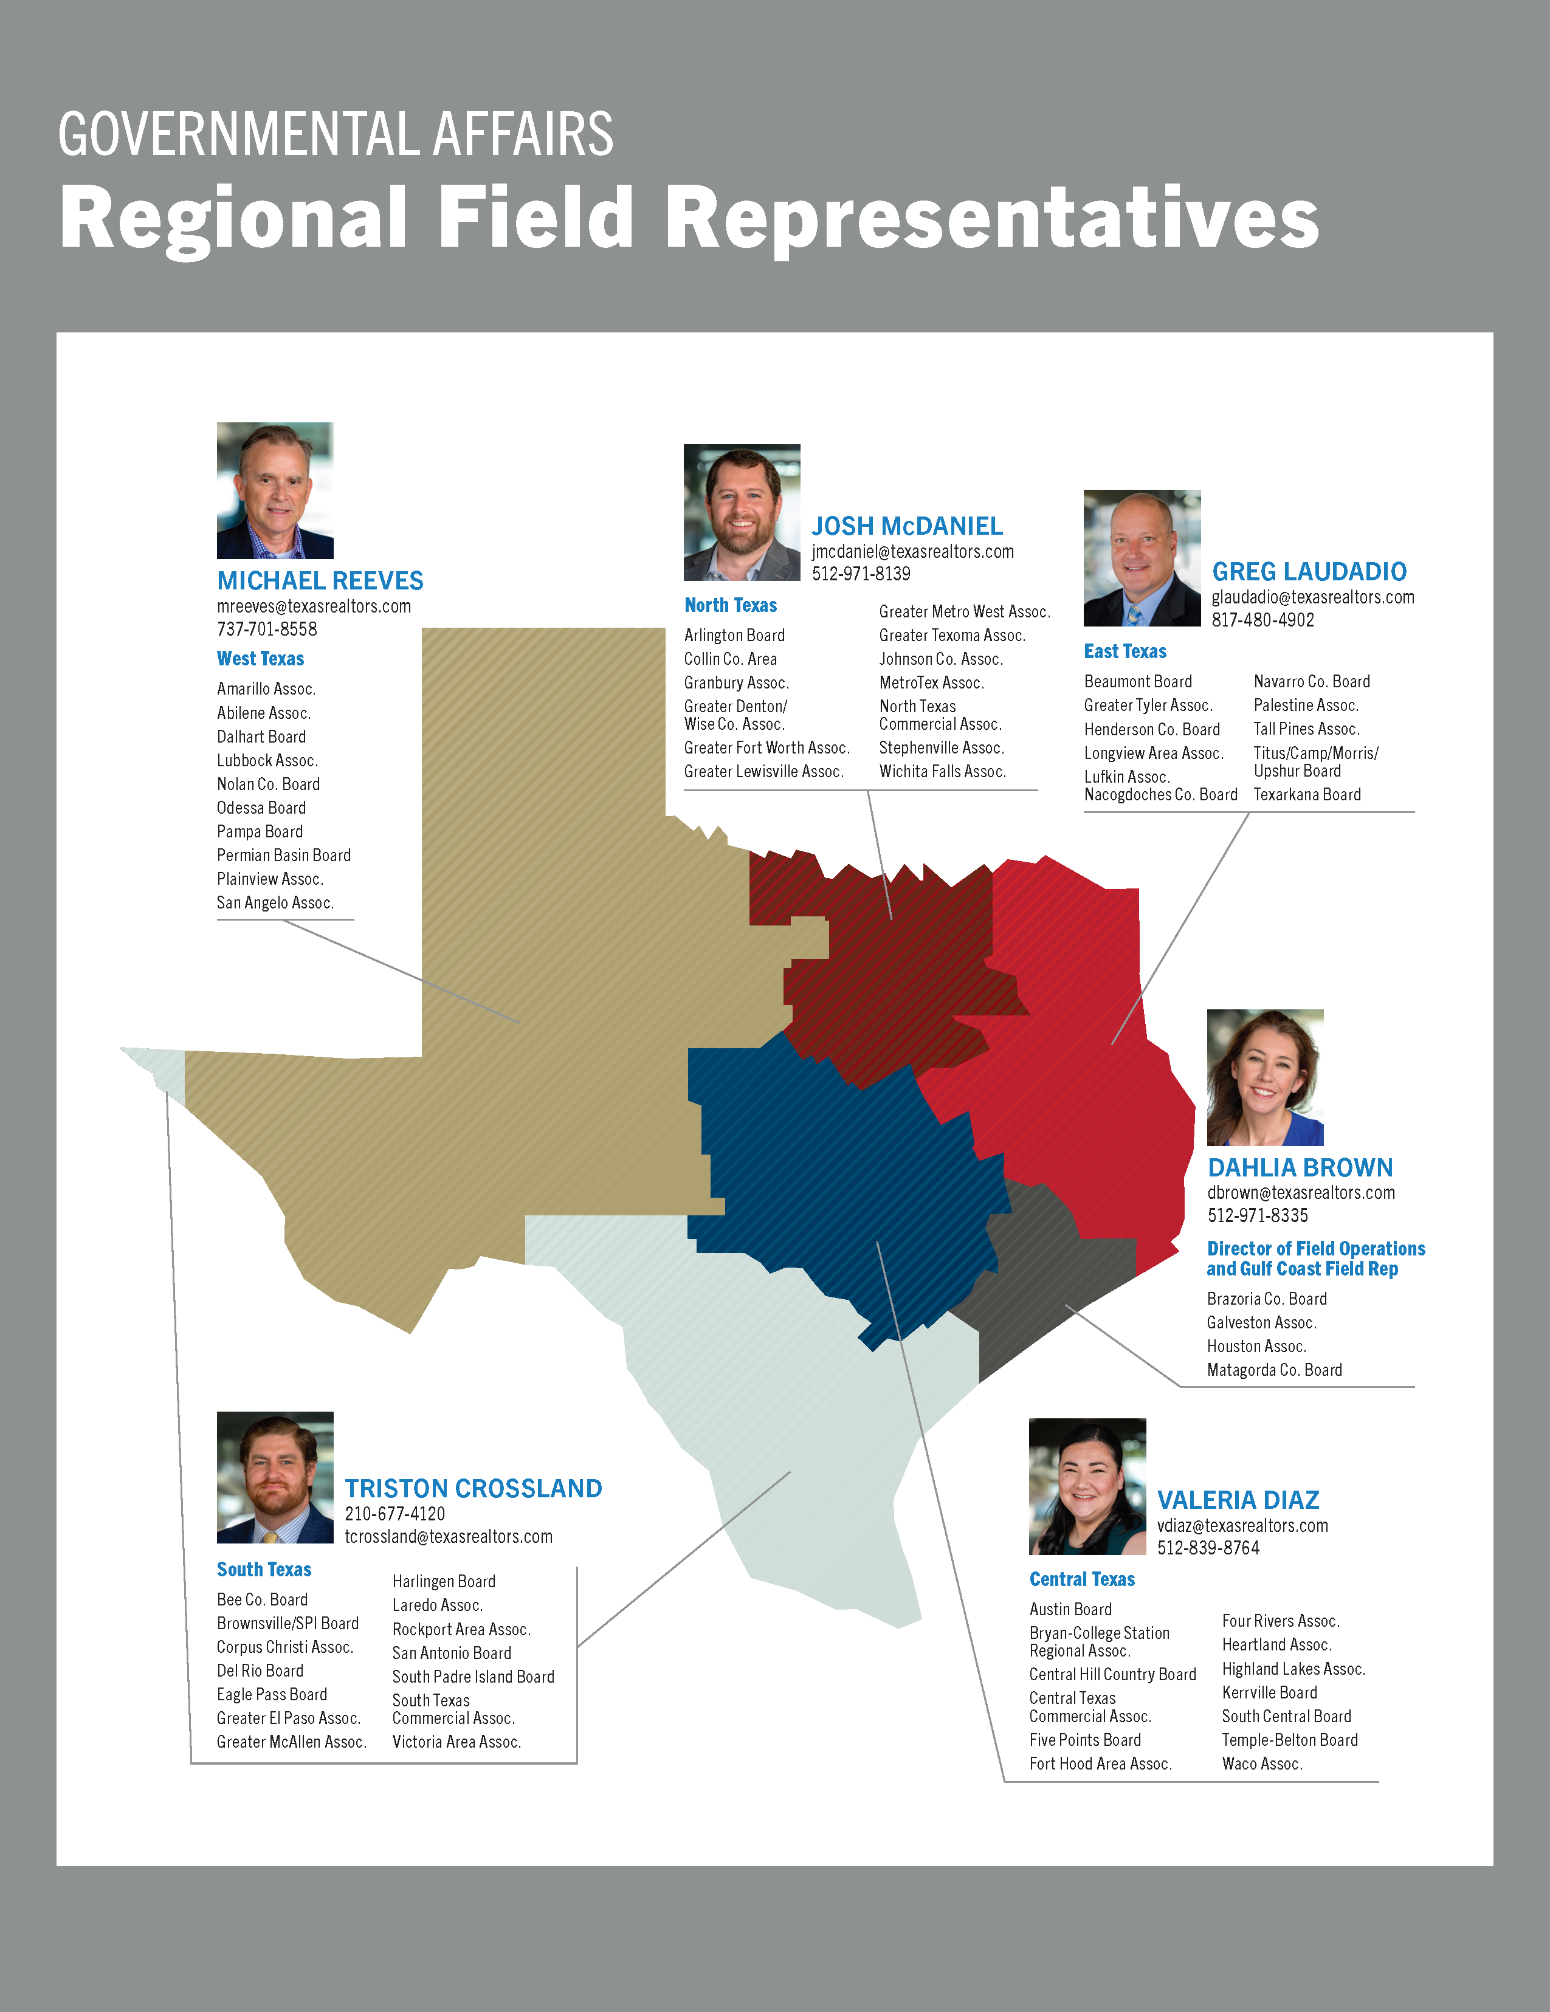
Field Representatives

Slide 21

RVP Best Practices & Bright Ideas

Slide 22
Texas REALTORS® Regional Vice Presidents Workshop
Thursday, August 21, 2025

