Slide 1

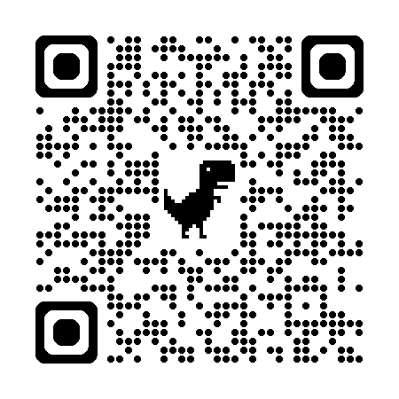
Legal Hotline
M-F, 9:00AM-4:00PM
512-480-8200
New Year, New Laws
Texas Real Estate Agency + Forms Changes Explained
Legal Updates

Slide 4


Notes:
The campaign is designed to promote the value that REALTORS® bring to the homebuying and selling process, specifically targeting individuals who have recently shown interest in purchasing a home.
Campaign timeline: Performance indicators included the number of impressions, how many people view our ads and how many people view our ads to completion.
Tactics in reaching our target audience include:
Digital display ads: served across the state on websites where consumers are in the real estate mindset, including Realtor.com and Zillow
Video ads: served across the state through YouTube and Connected TV like Apple TV, Roku and Amazon
Social: delivered across the state via Facebook and Instagram
Streaming Audio: reaching audiences across the state through Spotify and Sirius XM

Slide 5

Notes:
REALTORS® work to helping their clients in a legal, ethical manner. Several Texas REALTORS® services can help you reduce your risk. As a member, you have access to the Texas REALTORS® Legal Hotline, more than 140 peer-reviewed forms, and to 500+ legal FAQs. Texas REALTORS also offers a state-wide professional standards process.
Legal FAQs
If you’re ever searching for information on a topic, check out the Legal FAQs on texasrealestate.com. There, you can find more than 500 entries that address a wide variety of topics. FAQs are added and edited regularly to reflect current information.
Legal Hotline
The Texas REALTORS® legal hotline is available if you have a legal question about real estate. Our attorneys are dedicated to providing you with accurate, helpful information. You can call the Texas REALTORS® legal hotline at 512-480-8200. The legal hotline is open Monday through Friday from 9:00 a.m. to 4:00 p.m. Hotline attorneys answer approximately 1,500 calls every month.
Forms & contracts
In addition to the 27 TREC forms available to all licensees, Texas REALTORS® get more than 140 forms to use in a variety of real estate transactions, including leasing, property management, and commercial. These highly rated member forms are updated regularly to address industry changes and reduce liability for brokers, agents, and consumers. Many of the Texas REALTORS® forms have been translated to Spanish and Vietnamese. Note that the translations are for informational purposes only.
Code of Ethics
Of course, when you join any REALTOR® organization, you are agreeing to abide by a Code of Ethics when it comes to working with other members and serving your clients. This Code of Ethics was established over 100 years ago, and NAR was one of the first organizations to adopt a set of ethical standards. This Code of Ethics goes above and beyond the requirements of the law when it comes to serving clients.

Slide 6


Slide 7
